Slide 1
WELCOME

Slide 2


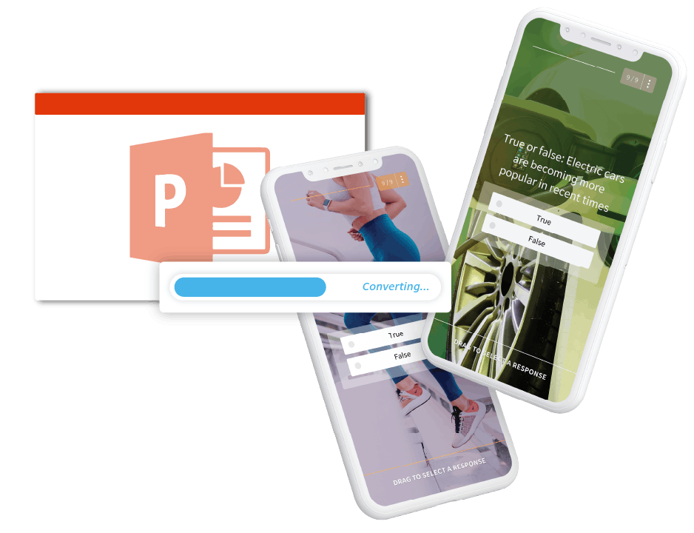
Usage of Mobile Phone
Presented By:
HUMA IMAM
ABDUL HADI
MUHAMMAD FAIZAN
MUHAMMAD ABDUALLAH
ABDUL REHMAN
Class / Section:
(2025-GA-25) / (A)
(2025-GA-51) / (A)
(2025-GA-11) / (A)
(2025-GA10) / (A)
(2025-GA-46) / (A)
Date: 18/11/2025

Slide 3

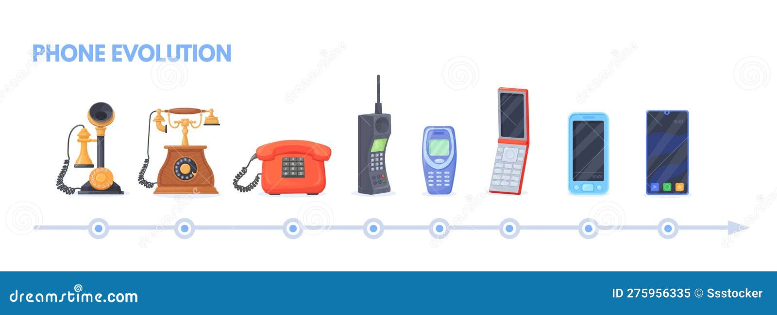
What is a mobile phone?
A mobile phone is a portable electronic device that allows you to make calls, send messages, and perform many other tasks such as using the internet, taking photos, watching videos, and using apps.
In simple words:
A mobile phone is a small computer that you can carry in your hand.
What can you do with a mobile phone?
Make and receive calls
Send and receive text messages
Use the internet (WhatsApp, YouTube, Google, Instagram, etc.)
Take photos and videos
Play games
Do online banking, shopping, navigation, and much more
Types of mobile phones:
Basic phone: Only for calls and SMS
Smartphone: Touchscreen, internet, camera, apps, and many more features

Slide 4

Introduction
Mobile phone is one of the most used devices today
It connects people across the world
Used for communication, education, entertainment and work
Mobile is now a basic need in modern life
More than 6.8 billion people use this thing
Early History of Mobile Phone:-
1973: First mobile phone call by Martin Cooper (Motorola) - weighed 2.4 kg.
1983: First commercial mobile phone, Motorola DynaTAC 8000X, launched (cost $3,995).
1990s: 2G & SMS introduced; phones became smaller, more accessible.
2007: iPhone (Apple) launched, transforming smartphones.
2010s: Android & app ecosystems boom; mobile phones became ‘smart’.
Note : The first mobile phone was developed by
Martin Cooper and his team at Motorola.- Martin
Cooper (credited as the inventor of the first
handheld mobile phone) made the first public
call on a mobile phone (April 3, 1973).

Slide 5
Growing Popularity
Not just for the elite anymore
Families began sharing mobile phones
Kids used them to stay in touch
Rural Impact
Helped in areas without landlines
Farmers used them for market prices and emergencies
Enabled faster communication during storms or disasters
Foundation for Modern Smartphones
Early phones introduced mobility and instant communication
Led to texting, apps, and internet-based smartphones
Massive technological evolution from bulky radios to smart devices
Challenges in Early Adoption
High roaming charges
Limited network coverage
Still considered expensive for many people
Early Use of Mobile Phones
Mostly used for emergencies and business
Considered a luxury device
Used by executives and professionals on the move
Rise of 1G Networks (1980s)
Analog mobile networks enabled wider use
Phones became smaller and slightly cheaper
People could make calls away from landlines
Felt like a “superpower” to own one
Limitations of Early Mobile Phones
Poor reception and call drops
Batteries drained quickly
Very expensive to buy and use
Digital Technology Arrives (1990s)
Shift from analog to digital networks
Better call clarity and security
Increased reliability for business communication

Slide 6
ABSTACTION
Mobile Penetration in Pakistan
85–90% of population owns a mobile phone
≈ 220 million users
Source: Pakistan Telecommunication Authority (PTA)
Communication & Connectivity
Primary mode of communication (voice/SMS)
Over 180 million active SIMs
Major operators: Jazz, Telenor, Zong
Important for rural areas where landlines are not available
Internet & Digital Services
70% internet users access internet via mobile
Popular uses:
  Social media (WhatsApp, Facebook, TikTok)
  Online shopping
  Video streaming
Mobile banking: Easy paisa + Jazz Cash = 50+ million users

Slide 7
Role of Mobile Phones in Youth Life
Mobile phones deeply influence education, social life, and future opportunities
Powerful tool if used wisely, but can also create challenges
Impact on Education
Game changer for students, especially in areas with limited school resources
Access to online learning apps (Khan Academy, Duolingo, YouTube lectures)
Useful during power outages and in rural areas
Helps create virtual study groups and self-learning
Challenge: Notifications and social apps can distract from studies
Digital Learning in Pakistan
Helps bridge the education gap in rural regions
Students can learn without needing modern libraries or expensive books
Mobile = Personal tutor in pocket
Social Impact on Youth
Quick communication through Snapchat, Instagram, WhatsApp
Builds global connections and friendships
Helps youth balance family and social circles
Encourages creativity (blogging, YouTube channels)
Challenges:
  Peer pressure & FOMO (fear of missing out)
  Online cliques and comparison culture
  Can reduce real-life interaction
Risks and Challenges
Screen addiction and sleep issues
Mental health concerns from social media pressure
Misinformation and fake news
Need for digital literacy and adult guidance

Slide 8
Effect of Mobile Phones on Mental Health and Cyberbullying
Mobile phones are essential in daily life
Constant use impacts mental health, especially among teenagers and young adults
Impact on Mental Health
Excessive social media use can cause:
  Anxiety
  Low self-esteem
  Depression
Pressure to appear “perfect” online leads to mental exhaustion
Constant notifications and endless scrolling disrupt focus and real-life connections
Screen Time & Sleep
Excessive screen time affects sleep patterns
Reduces attention span
Makes it harder to concentrate and retain information
Responsibilities
Responsible Mobile Use
Set boundaries:
Limit screen time
Avoid negative online spaces
Focus on real-life relationships
Parents and schools should guide responsible phone use
Cyberbullying
Mobile phones make bullying possible anytime, anywhere
Victims experience:
  Emotional distress
  Isolation
  Fear and shame
Cyberbullying can be more harmful than traditional bullying

Slide 9
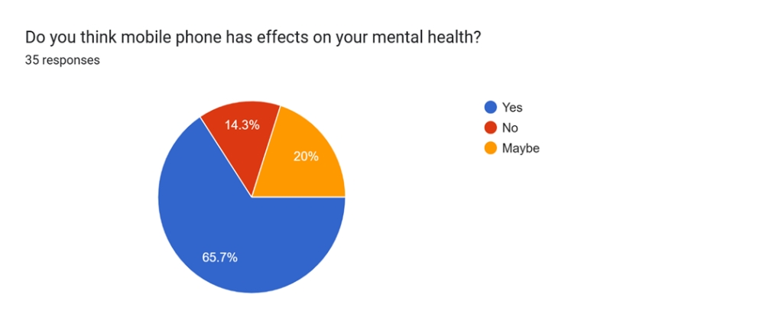
The survey we had done on the google form our response’s view in it and the reviews in such a way that that was most like its MENTAL HEALTH EFFECTED THE MOST.

Slide 10
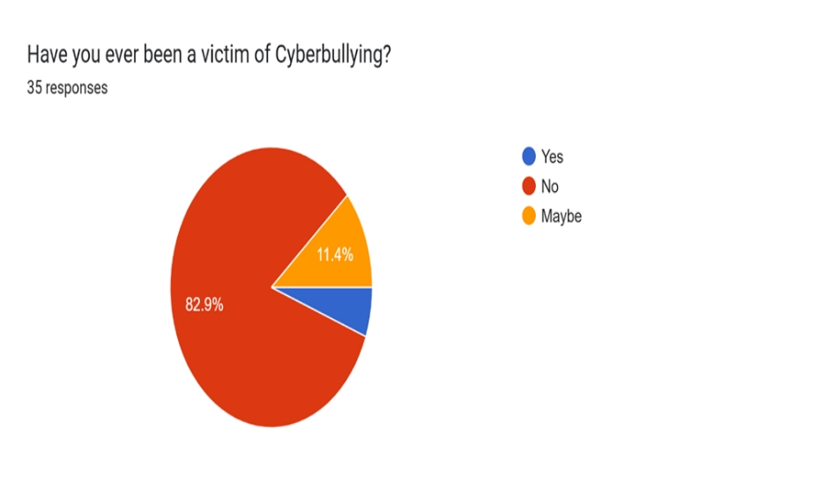
The survey we had done on the google form our response’s view in it and the reviews in such a way that that was most like its CYBER BULLYING.

Slide 11
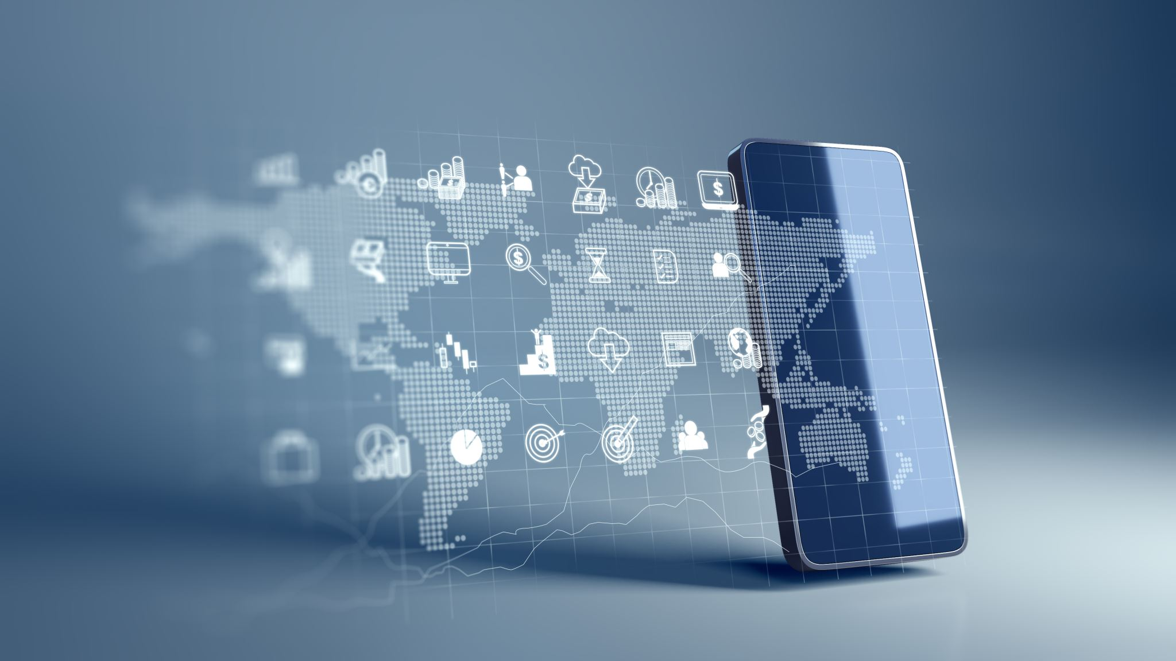
Impact of Mobile Phones
Mobile phones have multiple impacts on our lives
Two main areas: Connection Speed and Social Isolation
Impact on Connection Speed
Mobile phones do not directly control internet speed
Speed depends on:
  Service provider and network (4G, 5G, Wi-Fi 6)
  Signal strength
  Device capabilities
Newer phones have better wireless adapters and processors
Older phones may experience slower speeds even on the same Wi-Fi network
Impact on Social Isolation
Mobile phones have a dual role in social life:
Enhancing Connectivity:
Keeps people connected with family and friends across distances
Reduces loneliness, especially for those with limited mobility or in remote areas

Slide 12
Causing Social Isolation
Excessive phone use can replace face-to-face interactions
Phubbing (phone snubbing):
  Ignoring people during in-person conversations
  Reduces relationship satisfaction and social connectedness
Reduced Quality of Interactions:
  Presence of phones lowers trust, empathy, and conversation quality
Preference for Virtual over Real:
  Youth may prefer social media messaging over in-person communication
  Can hinder development of social skills and emotional intelligence
Conclusion
Mobile phones are powerful tools for connection but can cause isolation and mental health issues if misused
Balanced usage is key for maintaining healthy social and emotional life
Addiction & Mental Health
Over-reliance on phones linked to:
Loneliness
Anxiety and depression
Neglect of real-life relationships and responsibilities

Slide 13
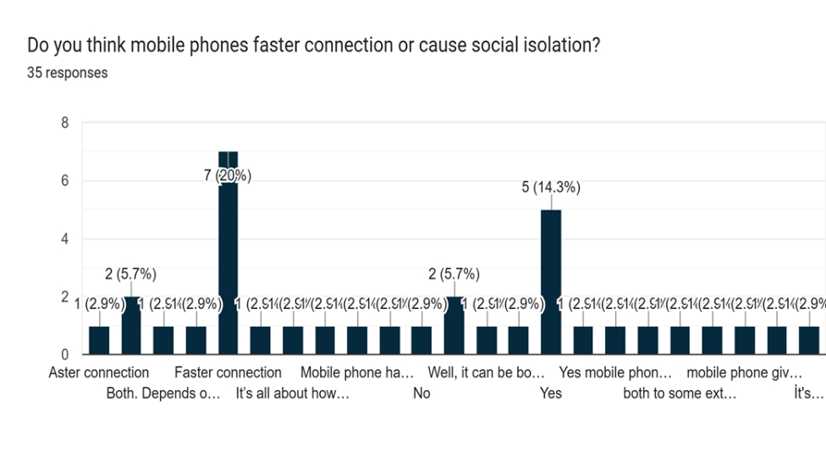
The survey we have done in it the following impact in such a way that is given in the graph that is shown below:

Slide 14
Conclusion – Mobile Phone Usage
Benefits of Mobile Phones
Connect people across distances
Provide instant access to information
Support activities like:
  Online banking
  Studying and learning
  Working and productivity
Enhance convenience and efficiency in daily life
Challenges of Mobile Phone Use
Overdependence can:
  Reduce focus and attention
  Limit face-to-face interactions
  Affect physical and mental health
Responsible Use
Key is balance and moderation
Enjoy advantages of technology without letting it control life
Encourages mindful usage for a healthier lifestyle

